Slide 1


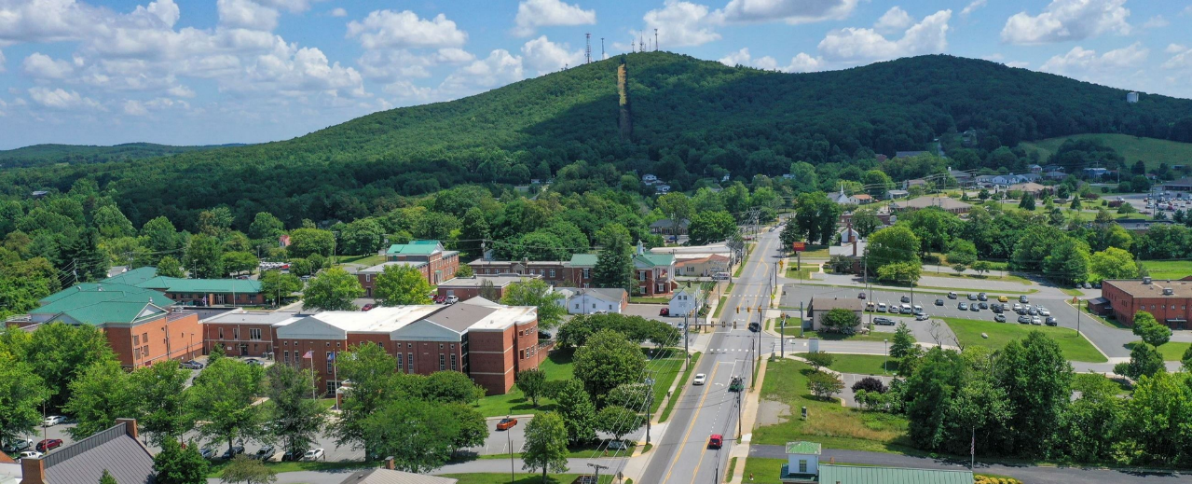
Campbell County, VA
5-Year Tactical Plan
Transfer Station & Increased Recycling Capabilities
Presentation to County Board of Supervisors
August 2024

Slide 2
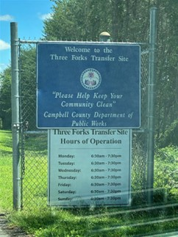

Background
Previous Tasks
5-Year Tactical Plan
Transfer Station Timeline
Siting and Budgeting
Planning and Design
Permitting and Approval
Engineering Design
Construction and Commissioning
Operational Transition
Increased Recycling Capabilities
Next Steps
Q&A
Today’s
Agenda
Notes:
We were here on [DATE] and were told to pursue Transfer Station (County-Only) and investigate increased recycling capabilities (ADD SLIDE TO RECAP PHASE ONE)

Slide 3

Background -
Task 1: Costing of Options
(County-Only Waste Scenario Shown)
1 – Landfill Expansion
2 – New Landfill
3 – Transfer Station
Net Present Value (NPV)
(Total Cost¹)
$190M
First Year Break Even Tip
(Cost per Ton)
$150 / Ton
Net Present Value (NPV)
(Total Cost¹)
$220M
First Year Break Even Tip
(Cost per Ton)
$193 / Ton
Net Present Value (NPV)
(Total Cost¹)
$114M
First Year Break Even Tip
(Cost per Ton)
$116 / Ton
(1) NPV is a calculation for long-term costs at today’s dollar value

Slide 4
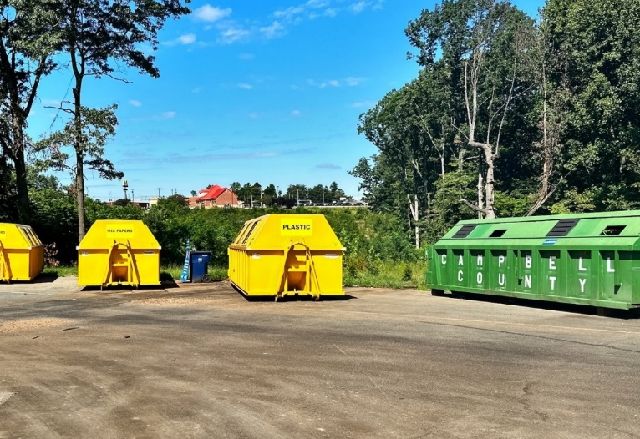
Task 2:
5-Year Tactical Plan

Slide 5

Goals
Fully operational waste transfer station by 2029
Seamless transition: landfill to transfer station
Regulatory & environmental standards compliance
5-Year Tactical Plan
Phase 1 (April 2024):
Solid Waste Management System Assessment
Phase 2 – Tactical Plan:
Roadmap towards implementation of new Transfer Station
County-owned
County-operated

Slide 6
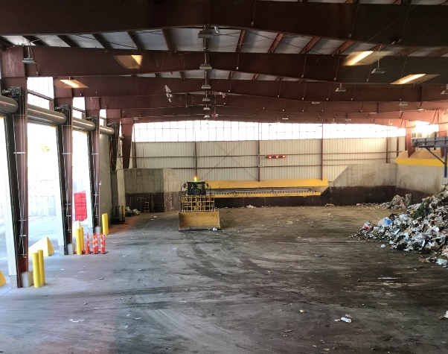
Transfer Station Implementation
Timeline

Slide 7


Project Phases – (Part 1: Planning)
1 - Siting & Budgeting
Site Study
Development/Construction Budget
O&M Budget
Public Outreach
2 - Planning & Design
Facility Plan
Facility Design
3 - Permitting & Approvals
Permit Applications
Zoning and Regulatory Approvals
Deliverable
Site selection & acquisition
Schedule:
Oct. 2024 – March 2025
Deliverable
Financing & budget approvals
Schedule:
April 2025 – Sept. 2025
Deliverable
Complete permitting process
Schedule:
Oct. 2025 – Sept. 2026

Slide 8
Project Phases - (Part 2: Implementation)
4 - Procurement & Engineering Design
Procurement
Contractor Selection
5 – Construction & Commissioning
Begin Construction
Commissioning/ Testing
Material Destination Agreements
Hauler Service Agreements
6 – Operational Transition
Staff Hiring & Training
Operational Readiness
Deliverable
Detailed engineering designs
Schedule:
April 2026 – September 2027
Deliverable
Complete construction
Schedule:
October 2027 - December 2028
Deliverable
Transition operation
Schedule:
January 2029 - September 2029

Slide 9
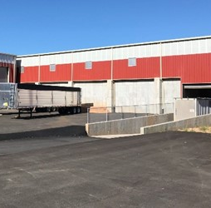

Phase 1
Siting and Budgeting
Deliverable:
Selection & acquisition of site for transfer station.
October 2024 – March 2025
Notes:
Deliverable: Site Selection and Acquisition
Phase One concludes with selecting and acquiring a site for the transfer station. (Note that if a site requires rezoning, this may impact the overall timeline.)

Slide 10

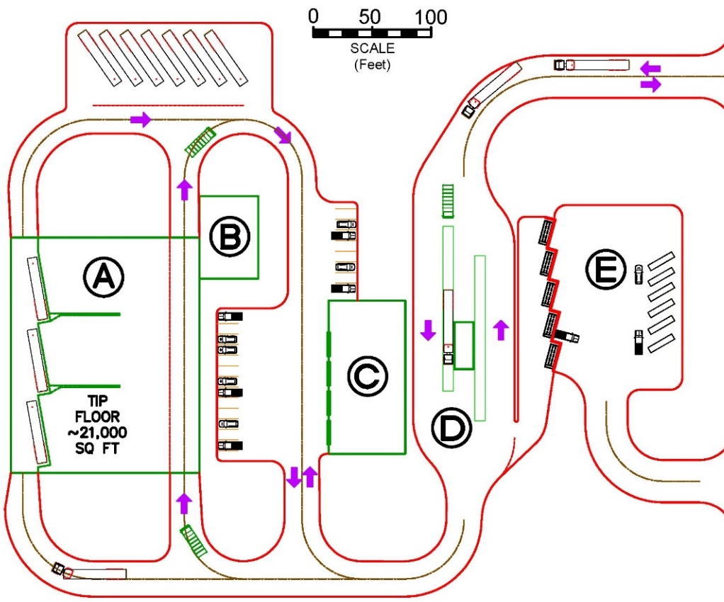
Potential Layout | Label | Site | Dimensions (ft) | Area (ft²)
 | A | Transfer Station | 160 x 200 | 32,000
 | B | Admin/Break Room | 50 x 70 | 3,500
 | C | Vehicle Maintenance Shop | 130 x 65 | 8,450
 | D | Scalehouse | 40 x 16 | 640
 | E | Citizen MSW Drop/ Recycling Drop | N/A
 |  | Total Lot Size | 550 x 640 | 8 Acres
Site Study
Study needed to identify viable locations
Selection factors
Size (Acreage)
Topography
Proximity
Population Centers
Transit Routes
Utilities
Zoning
Facilities
Cost
Current Ownership
Notes:
Site Study: To select a site for the transfer station, the County will need to complete a Site Study. The study should identify potential viable locations based on specifications and include an evaluation framework to help determine location trade-offs. Final site identification and procurement are not required for certain portions of other phases but do need to be completed prior to the final detailed budget (purchase and upgrade price estimates) and prior to beginning the permitting process.
Sketch: The following shows a potential layout for several facilities in an 8-acre site. This shows the larger transfer station at 32,000 ft² with 3 load-out bays, a maintenance shop, scales, and a citizen drop area. This sketch does not show a space for drainage ponds or other potentially necessary site needs but should help indicate the area needed for the different functionalities. Additional functions such as vehicle storage or recycling processing would require additional acreage.
The smaller 20,000 ft² transfer station would look similar but smaller by removing one of the load-out bays. This would not significantly alter the overall layout in this particular case.

Slide 11


Budget = Living document updated over time
Facility Assumptions
Sized to process 75,000 TPY with a single shift
Building: 20,000 square foot on 20-acre site
Clear-span metal building with doors / admin area / bathrooms
Site preparation costs: utilities, roads, and cement infrastructure
Equipment costs: scale, scalehouse, software, fire protection
Up-front capital costs breakdown (20% contingency excluding land)
Development & Construction Budget
Phase | Task | Estimated Cost (Present Day US$) | Fiscal Year
One | Site Study | $45,000 | 2025
 | Public Outreach | $30,000 | 2025
 | Budgeting | $150,000 | 2025-29
 | Solid Waste Management Plan | $200,000 | 2025
 | Site Acquisition | $1,000,000 | 2025
Two | Facility Plan | $50,000 | 2026
 | Facility Design | $100,000 | 2026
Three | Permitting | $600,000 | 2027-29
Four | Procurement Services | $100,000 | 2027-28
 | Engineering Designs | $150,000 | 2028
Five | Construction | $6,420,000 | 2028-29
 | Project Management | $200,000 | 2028-29
Six | (See O&M Budget)
 |  | $9,045,000
Cost Item | Cost
Building ($130/sq. foot) | $3,120,000
Site Prep Costs Estimate | $2,400,000
Land Cost ($50,000/acre) | $1,000,000
Equipment Cost and Installation | $900,000
Total | $7,420,000

Slide 12

Annual Operations Costs
Rolling stock
Maintenance of facility
Cost of labor (13 FTE)
Tends to be relatively steady
Hauling & Disposal Costs
Largest O&M expense; usually 65% of annual costs
Assumed to be performed by 3rd party
More volatile costs
Operation & Maintenance Budget
Costs | Estimated Annual Cost
Building and Grounds Improvement Capital Costs | $539,055
Rolling Stock Capital Costs | $252,397
Total O&M (w/o labor) with Contingency, Overhead & Profit | $344,461
Labor Costs | $1,055,655
Hauling and Disposal Costs | $3,939,317
Total | $6,130,885
$119.29 per received ton (at 51,402 tpy)
Transfer Station Costs | Est. Annual Cost | Cost per Ton | Percentage of Total
Capital, Labor and O&M Costs | $2,191,568 | $42.64 | 36%
Hauling and Disposal Costs¹ | $3,939,317 | $76.64 | 64%
(1) Disposal Costs are Highly Dependent on Contracted Tip Fee Costs at Regional Landfills

Slide 13


Public Outreach
Public / stakeholder engagement strategy may be needed
Based on level of project buy-in necessary for transfer station construction
Scope and timeline to be determined based on outreach strategy required
Outreach Tools
Online survey
Phone survey
Public meetings
Stakeholder interviews
Target Groups
Large waste generators
Businesses
Haulers
Residents
Notes:
The County may need to create a public and/or stakeholder engagement strategy based on the level of project buy-in necessary to move forward with the construction of a new transfer station. The strategy may include an online survey, phone survey, public meetings, and stakeholder interviews and can target specific groups (e.g., large waste generators, businesses, haulers, residents). The scope and timeline for outreach implementation will depend on the goals of the outreach strategy as determined by the Board of Supervisors and the level of public engagement and buy-in necessary to move this project forward.

Slide 14

Solid Waste Management Plan
Virginia regulation planning requirements overview:
Basic planning elements
Minimum recycling rate
Data and analysis
Solid waste disposal sites information
Solid waste generation monitoring/reporting methodology
Plan adoption resolution
Plan goals / Corrective action
If County discontinues participation in Region2000, Plan needed:
Submitted to Commonwealth of Virginia
Every 20 years: new plan
Every 5 years: updates
Significant effort:
16-20 months of staff work
Outside consultant
Notes:
Supposing the County were to discontinue its participation in Region2000 to meet its future solid waste management needs, it will need to draft its own Solid Waste Management Plan, submit it to the Commonwealth of Virginia every 20 years, and update it every five years. This is a significant effort that will likely require 16-20 months of staff work and will likely require an outside consultant as current staff will not have the capacity for this work. Virginia regulation 9VAC20-130-120 includes the following planning requirements:

Slide 15
Part 1: Planning Summary -
Siting and Budgeting
1 - Siting & Budgeting
Site Study
Development/Construction Budget
O&M Budget
Public Outreach
Phase 1 Tasks | Estimated Cost (Present Day US$) | Fiscal Year
Site Study | $45,000 | 2025
Public Outreach | $30,000 | 2025
Budgeting | $150,000 | 2025-29
Solid Waste Management Plan | $200,000 | 2025
Site Acquisition | $1,000,000 | 2025
Total | $1,425,000
Deliverable
Site selection & acquisition
Schedule:
Oct. 2024 – March 2025

Slide 16

Phase 2
Planning and Design
Deliverable:
County will need to obtain approvals for funding and overall budget before breaking ground.
April 2025 – September 2025
Notes:
Deliverable: Funding and Budget Approvals
After Phase Two, the County will need to obtain approvals for funding and the overall budget for the project before breaking ground.

Slide 17
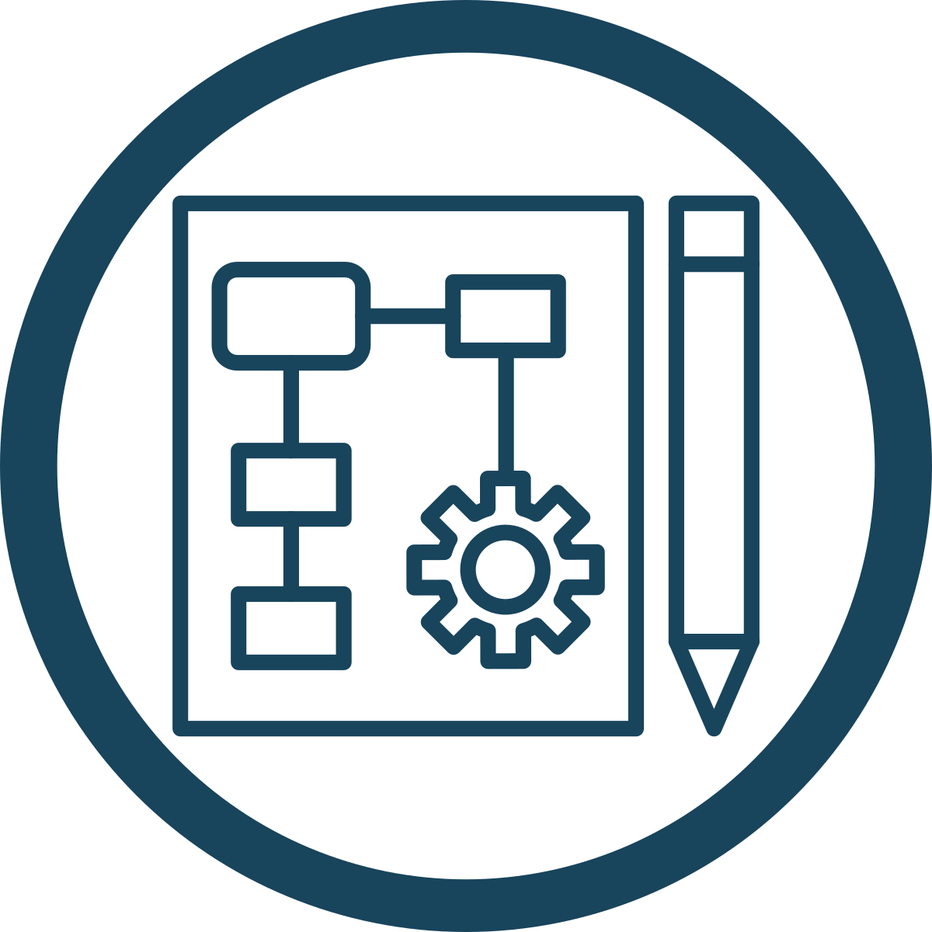


Planning and Design
Facility Plan
Engage A&E firm or work with Solid Waste Management Planning consultant and engage A&E firm once basic facility plan in place.
Components:
Maintenance Plan
Risk Management Assessment
Staffing
Facility Design
For preliminary and detailed facility design, County must finalize:
Site functionality requirements
Approximate footprint of buildings/infrastructure
Approvals
Zoning
Regulatory standards

Slide 18

Phase 3
Permitting and Approval
Deliverable:
County must complete the permitting process.
October 2025 – September 2029
Notes:
Deliverable: Complete Permitting Process
At the end of Phase Three, the County must complete the permitting process.

Slide 19



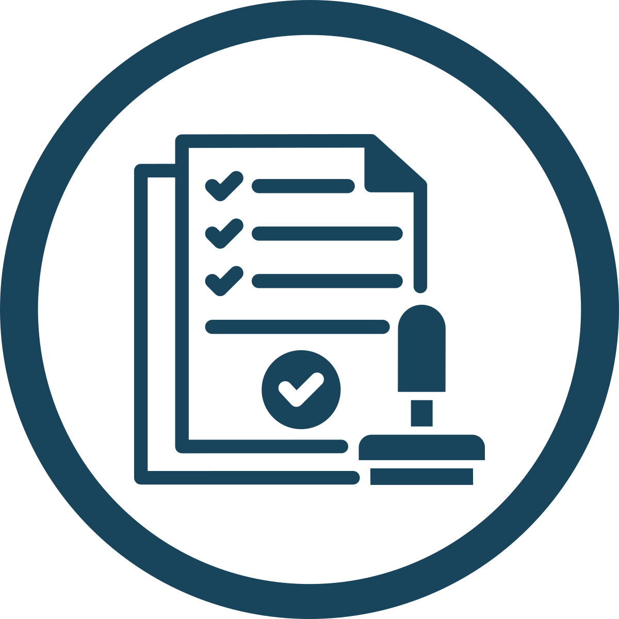
Necessary to obtain:
Permit Applications
Solid waste permit
Fundamental to accepting MSW at the site
Sufficient to start process:
Estimated tonnage daily limits
Facility Design drawings
Utility and Groundwork permits
Building permits
Electrical
Fire
Sewer
Final occupancy permit
Correct site zoning needed
Permitting occurring in conjunction with
Facility Design
Detailed Design

Slide 20
Phase 4
Procurement and Engineering Design
Deliverable:
Final detailed engineering design, including footprint and elevation drawings for all buildings and necessary infrastructure for construction.
April 2026 – October 2026
Notes:
Deliverable: Detailed Engineering Design
At the end of Phase Four, the County should have a final detailed engineering design in hand, including the final footprint and elevation drawings for all required buildings and necessary infrastructure for construction.

Slide 21
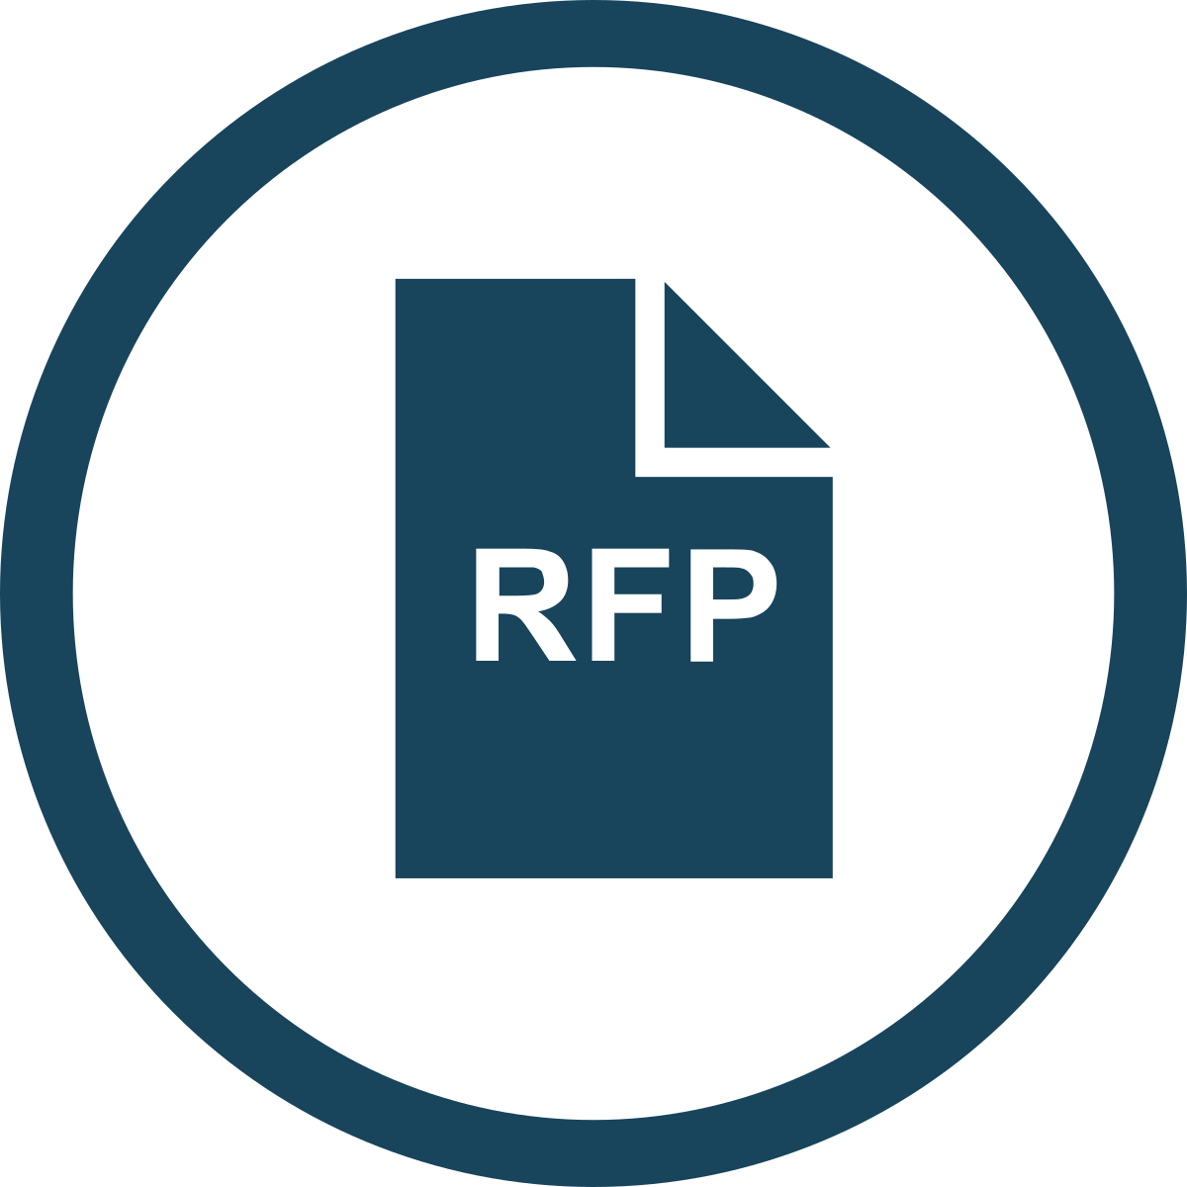

Procurement and Engineering Design
Procurement
Establish project structure and how construction will be managed
Establish scope of procurement needs and requirements
Establish selection criteria
Generate and issue RFP
Contractor Selection
Narrow down and select contractor(s) based on selection criteria
Work with chosen party to finalize the construction timeline

Slide 22
Part 2a: Planning and Design Summary-
Design and Permitting
Phases 2-4 – Design, Permitting, and Engineering
Planning and Design
Permitting and Approvals
Procurement and Engineering Design
Phase 2-4 Tasks | Estimated Cost (Present Day US$) | Fiscal Year
Facility Plan | $50,000 | 2026
Facility Design | $100,000 | 2026
Permitting | $600,000 | 2027-29
Procurement Services | $100,000 | 2027-28
Engineering Designs | $150,000 | 2028
Total | $1,000,000
Deliverable
Permitted and Engineered Transfer Station Building and Grounds ready for Construction
Schedule:
April 2025 – Oct. 2028

Slide 23

Phase 5
Construction and Commissioning
Deliverable:
Completed facility construction.
October 2026 – April 2028
Notes:
Deliverable: Complete Construction - Phase Five concludes at the end of the building period once facility construction is complete.

Slide 24



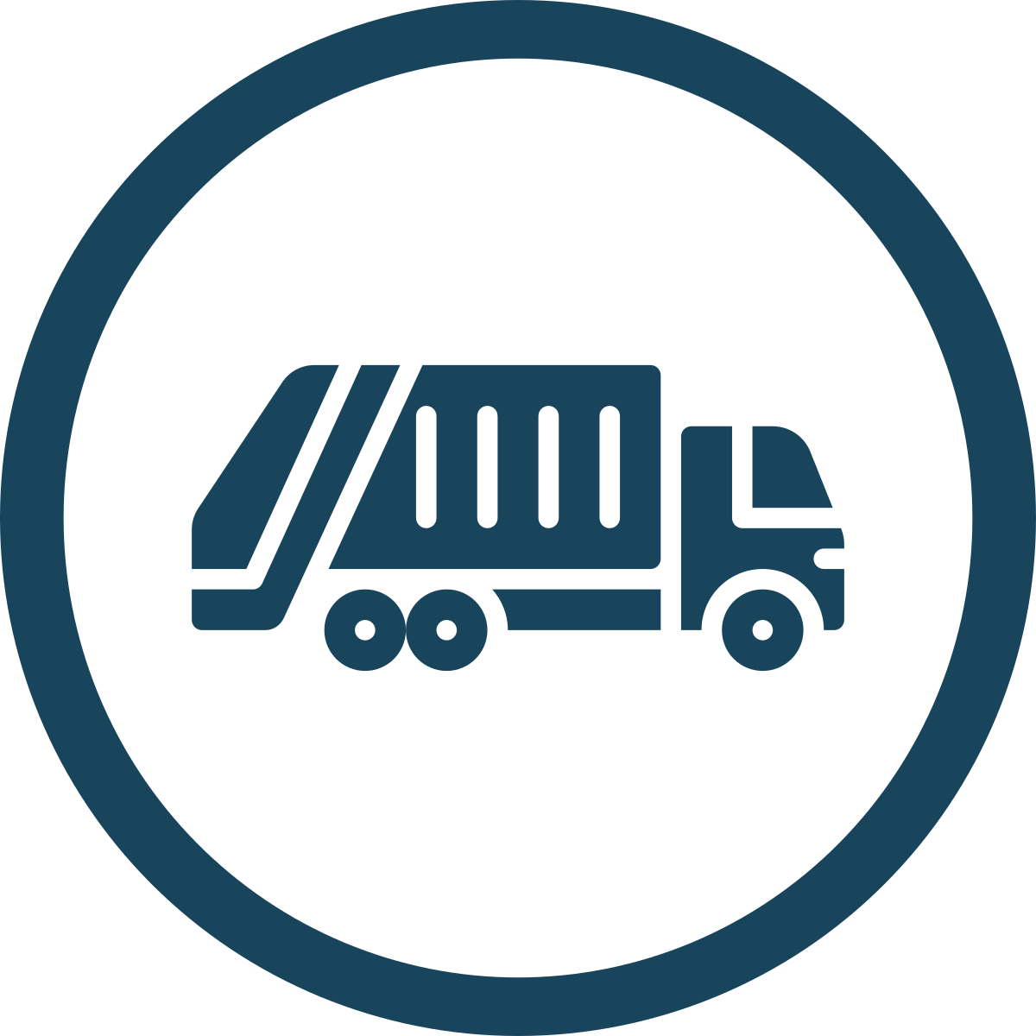
Construction and Commissioning
Construction
Execute oversight plan during construction
Monitoring and quality control checks
Material Destination Agreements
Secure allowable tonnages and tipping fees with regional landfill locations
Commissioning & Operational Testing
Oversee system testing, safety checks, and quality assurance for all systems
Hauling Contracts
Sign hauling contracts for anticipated tonnages to contracted destinations

Slide 25

Phase 6
Operational Transition
Deliverable:
Ready to transition operations from landfill to transfer station.
January 2029 – September 2029
Notes:
Deliverable: Transition Operations - At the end of Phase Six, the County will be ready to transition operations from the landfill to the transfer station.

Slide 26



Operational Transition
Hiring
Write job descriptions
Make salary determinations
Allocate staff time
Advertise positions
Complete the hiring process
Training
Develop detailed training programs covering:
Waste handling
Safety procedures
Equipment use
Emergency protocols
Create training manuals
Create standard operating procedures
Operational Readiness
Perform comprehensive testing:
Waste sorting
Waste handling
Transportation mechanisms
Verify safety systems
Ensure operations comply with regulations

Slide 27
Part 2b: Implementation -
Construction and Transition
Phases 5-6 – Construction, Commissioning and Operation
Construction of Transfer Station
Commissioning of Transfer Station
Operational Transition
Full-time Operation
Phase 5-6 Tasks | Estimated Cost (Present Day US$) | Fiscal Year
Construction | $6,420,000 | 2028-29
Project Management | $200,000 | 2028-29
Est. Annual Operating and Disposal Costs (Year 1) | $6,130,885 | 2029-30
Total | $12,750,885
Deliverable
Operating Transfer Station
Schedule:
Oct. 2026 – Fall 2029
Summary Tasks | Total Estimated Cost | Fiscal Year
Siting, Budget and SWMP | $1,425,000 | 2024-25
Planning and Design | $1.000,000 | 2025-28
Implementation | $12,750,885 | 2028-30
Total | $15,175,885

Slide 28
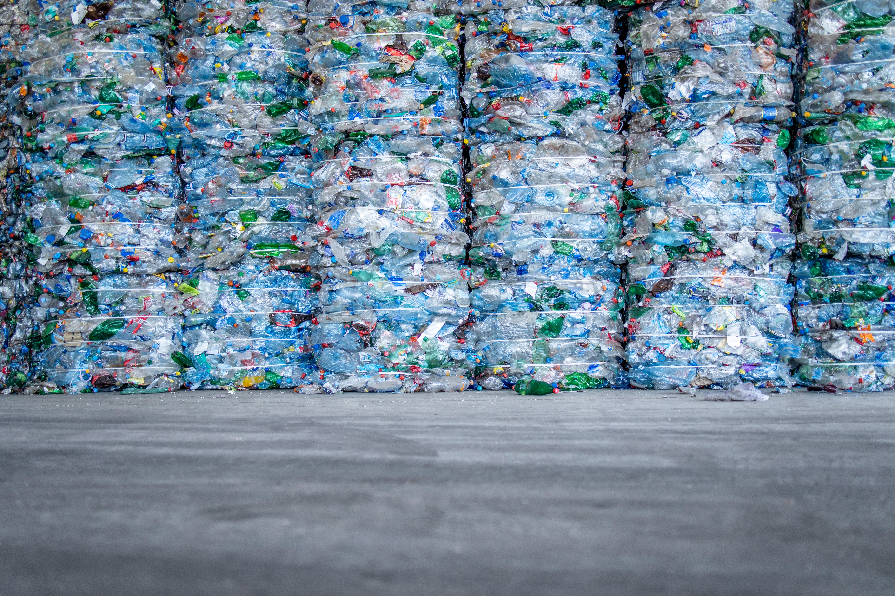
Increased Recycling Capabilities
Additional costs and infrastructural considerations if the County improves its recycling and resource recovery capabilities.

Slide 29
Projected Waste Generation – Campbell County (based on the current recycling programs and rates)
Volume and Composition
 | Residential |  |  | Commercial
FY | MSW | Recycling | Generation | MSW | Recycling | Generation
FY 29-30 | 26,341 | 536 | 26,877 | 25,061 | 18,151 | 43,212
FY 39-40 | 27,006 | 549 | 27,555 | 25,694 | 18,609 | 44,303
FY 49-50 | 28,055 | 571 | 28,626 | 26,692 | 19,332 | 46,024
FY 58-59 | 29,037 | 591 | 29,628 | 27,627 | 20,009 | 47,636
Estimated Composition¹ – Campbell County
Residential Waste Stream
59% comprised of theoretical recyclable material
Commercial Waste Stream
61% comprised of theoretical recyclable material
 | Residential |  | Commercial
Material Category | Average | Tons | Average | Tons
Organics | 26.8% | 7,058 | 18.9% | 4,738
OCC | 4.0% | 1,060 | 9.2% | 2,309
Other Fibers | 7.7% | 2,041 | 6.6% | 1,657
Glass | 2.3% | 596 | 1.3% | 330
PET | 1.9% | 509 | 1.3% | 336
HDPE-N | 0.4% | 115 | 0.5% | 122
HDPE-C | 0.6% | 154 | 0.3% | 83
Mixed #1-#7 | 2.4% | 639 | 6.3% | 1,580
Other Plastics | 9.3% | 2,451 | 12.6% | 3,146
Aluminum Cans | 0.5% | 137 | 0.3% | 74
Ferrous Cans | 1.1% | 291 | 0.6% | 143
Mixed Metals | 2.0% | 524 | 3.1% | 765
Other Residue | 40.9% | 10,785 | 39.1% | 9,789
Total | 100% | 26,361 | 100% | 25,074
(1) Composition Estimated from Recent Studies in North Carolina and Michigan
Notes:
With approximately 60% of the residential waste stream comprised of recyclable material, this forms the base of the total tons of material that could potentially be recovered and recycled. There is currently no possibility of a 100% recovery rate through which all of this tonnage could be recovered.
As notes above, that Other Residue refers to non-recyclable content. Using the aforementioned waste characterization data to form the waste composition assumptions indicates that 60.9% of the commercial MSW that is currently being disposed is recyclable. As with residential waste, this figure represents the total tons of recyclable material in the waste stream and does not indicate the amount that is recoverable through collections and processing.

Slide 30
Equipment and Infrastructure
Facilities needed to process recyclable materials in the County:
Material Recovery Facility
Food and Organic Waste Recycling
Glass
Mixed Waste Processing
Option 1: Manual Sorting with Baler (2 TPH)
Option 2: Process Commercial and out of county Single Stream (4-5 TPH)
Straightforward solution: Relationship with Royal Oak Farms in Bedford County
Green boxes with glass drop-off:
Higher-value recycling stream
Increased waste diversion
Not viable option for reducing the amount of MSW landfilled under the current conditions
Notes:
In order to process the recyclable materials identified above, the County needs equipment and/or infrastructure to do so. The following is a description of the facilities needed to process recyclable materials in the County. The following section includes a description and cost of additional material recovery infrastructure to include the following possible streams for processing:
Material Recovery Facility (MRF)
Food and Organic Waste Recycling
Glass
Mixed Waste Processing

Slide 31
Recycled Material Collected per Program
Total Recycling Volume
Scenarios | Residential Single Stream TPY | Commercial Single Stream TPY | Total Collected Single Stream TPY
Enhanced Drop-Off (Option 1) | 1,400 | 600 | 2,000
Curbside Collection (Residential) (Option 1) | 2,500 | 1,000 | 3,500
Curbside w/ Commercial (Option 2) | 2,800 | 3,200 | 6,000
Enhanced Drop-Off Single Stream Recycling
Green Box sites upgraded
Drop-off of all material
Residential Curbside Recycling
Every other week single stream collection
No opt-in fee
Enhanced Drop-Off also in place
Curbside Recycling w/Commercial Recycling
Would Require Ordinance to Require Extra Bins and Collections at Commercial Sites
Notes:
The following table shows the total volume of recycled material collected based on the implementation of programs and capture of the various waste streams. These totals are used to estimate the tons processed at the MRF (as well as the residue).

Slide 32
Total Recycling Recovery
MRF Options
Option 1 MRF
Option 2 MRF
2 TPH System
Mostly Manual Sorting
1 Magnet and Baler
Annual Capacity (1 Shift) 3,640 TPY
Approx. 10 Sorters needed
5 TPH System
Some Automation
OCC Screen, Magnet, ECS and Baler
Annual Capacity (1 Shift) 9,100 TPY
Approx. 10 Sorters needed
Material | Recovery Rate
OCC | 75.0%
Other Fibers | 75.0%
Glass | 25.0%
PET | 75.0%
HDPE-N | 85.0%
HDPE-C | 85.0%
Mixed #1-#7 | 0.0%
Other Plastics | 0.0%
Aluminum Cans¹ | 75.0%
Ferrous Cans | 90.0%
Mixed Metals | 75.0%
(1) Option 2 Increases Aluminum Recovery to 90% or better with addition of an ECS unit

Slide 33
Total MRF Recycling Recovery
Collection Option | Enhanced Drop-off | Curbside Recycling | Curbside w/ Commercial
Material Category | Total Recovered (TPY) | Total Recovered (TPY) | Total Recovered (TPY)
Total Processed (TPY) | 2,000 | 3,500 | 6,000
OCC | 1,067 | 1,067 | 1,067
Other Fibers | 861 | 861 | 861
Glass | 205 | 205 | 205
PET | 188 | 188 | 188
HDPE-N | 58 | 58 | 58
HDPE-C | 101 | 101 | 101
Mixed #1-#7 | 143 | 143 | 143
Other Plastics | 119 | 119 | 119
Aluminum Cans | 51 | 51 | 51
Ferrous Cans | 72 | 72 | 72
Mixed Metals | 35 | 35 | 35
Remaining Residue¹ | 790 | 1,383 | 2,357
Total Recovered | 1,210 | 2,117 | 3,643
(1) Residue Assumed to be Sent to Transfer Station for Disposal
Notes:
As indicated in the above tables, the collected single stream will also contain non-program materials such as Organics and Other Residue, as well as materials that may not have a market and may not be recovered at the MRF, such as Mixed Plastics. In addition, not all recyclable items will be recovered at a MRF. Some get missed or placed in the wrong materials, meaning that 100% recovery of the incoming materials is not practical or possible. The MRF processing model looks at the estimated incoming materials and assumes they have an average composition similar to the single streams from Kent and Mecklenburg Counties (that also have a mix of residential and commercial single stream). The model also estimates the recovery based on other manual or equipment sorting from other similar MRFs. If the incoming tonnage is a little less than expected, it is possible that manual recoveries might be slightly higher, but this should give a good estimate of recovery at the designated tonnages.

Slide 34
MRF Facility Assumptions – Capital Costs
Co-located with Transfer Station
5 acres / 18,000 ft² building
Clear-span metal building with doors
Cement requirements: tip area/equipment processing structures
Site preparation costs:
Utilities, roads & additional infrastructure
Permitting
Utilities assumed to be close by
Equipment costs: do not include a scale and scale house
Option 1 equipment:
Infeed chain belt conveyor
Sort conveyor on a bunker platform
2 transfer conveyors
Magnet
Baler with separate infeed conveyor
Option 2 equipment ALSO includes:
OCC and Fines screen
ECS unit
Additional transfer conveyor for recovered materials
Fiscal Implications
MRF Options
Less single-stream material processed
Requires less staffing 2 tph capacity
Additional commercial recycling collected
Equipment enhancements
OCC screen
Eddy current separator
4 tph capacity

Slide 35
Summary of Annual Capital and O&M Costs
 | MRF Estimated Annual Cost
 | Option 1 | Option 2
Building, Equipment and Grounds Improvement Capital Costs | $406,834 | $443,158
Rolling Stock Capital Costs | $78,671 | $78,671
Total O&M (w/o labor) with Contingency | $305,306 | $331,827
Labor Costs | $871,817 | $871,817
Total | $1,662,628 | $1,725,474
Fiscal Implications
Estimated Commodity Revenue & Disposal Savings Recycling
 | Enhanced Drop-Off Collections (Option 1) | Curbside Residential Collections (Option 1) | Curbside with Commercial Collections (Option 2)
Revenue Estimate (Nov. 2023 Prices) | $134,010 | $234,518 | $417,965
Estimated Hauling & Disposal Diversion Savings | $92,720 | $162,261 | $279,170
Total Annual Revenue & Disposal Diversion | $226,730 | $396,778 | $697,135
Annual Capital and Processing Costs | $1,662,628 | $1,662,866 | $1,725,474
Net Difference | ($1,435,898) | ($1,266,087) | ($1,028,339)
The costs per ton for Option 1 seem to indicate that utilizing the transfer station to collect the recyclables and hauling them to a regional MRF might be less expensive than constructing and operating a local MRF.
However, Option 2 indicates that the cost per ton to process recyclables at a local MRF may be near equivalent to hauling the materials to a regional MRF.
Cost Difference Between Capital & Operation Costs, Commodity Revenue & Disposal Savings
 | Tons Processed | Annual Cost Difference | Cost Difference per Processed Ton
Enhanced Drop-Off Collections (Option 1) | 2,000 | ($1,435,898) | ($717.95)
Curbside Residential Collections (Option 1) | 3,500 | ($1,266,087) | ($361.74)
Curbside with Commercial Collections (Option 2) | 6,000 | ($1,028,339) | ($171.39)
Notes:
Discuss how this could work financially at scale

Slide 36
Total Costs With Recycling Options
Collection Option | Enhanced Drop-off | Curbside Recycling | Curbside w/ Commercial | Commercial w/ Glass and Organics
Total Annual Revenue & Disposal Diversion¹ | $226,730 | $396,778 | $697,135 | $1,173,070
Annual Capital and Processing Costs | $1,662,628 | $1,662,866 | $1,725,474 | $2,159,005
Transfer Station Costs | $6,130,885 | $6,130,885 | $6,130,885 | $6,130,885
Total Net Difference | ($7,566,783) | ($7,396,973) | ($7,159,224) | ($7,116,820)
Net Cost per Ton² | ($147.21) | ($143.90) | ($139.28) | ($138.45)
This is the combination of sold commodities and the diversion of tons hauled and disposed at the transfer station
Net Cost per Ton is calculated from the overall tonnage collected at 51,402 TPY. Transfer Station cost per ton estimated at $119.27 per ton

Slide 37
Funding Sources
Programs & Policies
Solid Waste Infrastructure for Recycling
The Recycling Partnership
Education
Solid Waste Management Plans
Other Programs and Policies
Residential Curbside Recycling Cart Grants
Residential Drop-Off Recycling Grant Program
Multifamily Recycling Program Grants
Additional Considerations
Notes:
Funding Sources
Funding sources for transitioning a community away from landfill-dominant disposal are expanding. In the past few years, we have seen federal grants from agencies like the EPA, DOE, and USDA, as well as private foundations like the Recycling Partnership, to support local governments in increasing waste diversion.
Solid Waste Infrastructure for Recycling (SWIFR), US, EPA
On September 13, 2023, the EPA announced the selectees for the Solid Waste Infrastructure for Recycling grants for Communities and the recipients of the recycling grants for States and Territories. Then, on November 15, 2023, EPA announced the selectees for the Solid Waste Infrastructure for Recycling Grants for Tribes and Intertribal Consortia. Check out the list of recipients and selectees. The next round of SWIFR funding will likely be made available in 2025. As of the publication of this report, the RFP has yet to be released.
The entities eligible to apply for the Solid Waste Infrastructure for Recycling Grants for Communities are political subdivisions of states and territories. EPA considers counties, cities, towns, parishes, and similar units of governments that have executive and legislative functions to be political subdivisions of states and territories.
The Bipartisan Infrastructure Law provides $275,000,000 total from Fiscal Year 2022 to Fiscal Year 2026 for grants authorized under the Save Our Seas 2.0 Act. Projects funded through the funding opportunity will:
Implement the “building a circular economy for all strategy series.”
Improve local post-consumer materials management programs, including municipal recycling.
Make improvements to local waste management systems.
Eligible Activities: Materials and waste streams within the scope of this funding opportunity include municipal solid waste, including plastics, organics, paper, metal, glass, and construction and demolition debris. This also includes the management pathways of source reduction, reuse, sending materials to material recovery facilities, composting, industrial uses (e.g., rendering, anaerobic digestion), and feeding animals.
The Recycling Partnership (a private foundation)
The Recycling Partnership works with communities and recycling facilities, including materials recovery facilities, processors, and secondary processors, across the U.S. to improve access, collections, operations, and processing through various grant and technical assistance opportunities. Campbell County would be eligible for all of TRP’s grant programs.
Residential Curbside Recycling Cart Grants: Through The Recycling Partnership’s Residential Curbside Recycling Cart Grant, communities are provided grant funding, technical assistance, and the design of education and outreach materials to help advance recycling and improve recycling access and capacity for U.S. residents. Communities considering any of the following three system improvements are encouraged to apply:
Implementing a new cart-based curbside recycling program
Converting existing bin or bag-based programs to carts
Expanding service area to improve access and equity
Residential Drop-Off Recycling Grant Program: Communities are provided grant funding, technical assistance, and the design of education and outreach materials to help advance recycling and improve drop-off access and capacity for residents. Communities considering any of the following system improvements are encouraged to apply:
Constructing new drop-off sites to expand recycling access.
Infrastructure enhancements to connect to regional MRFs or transfer stations through hub-and-spoke model transportation.
Converting existing drop-off sites from unstaffed to staffed sites.
Implementing commingled compaction for collection efficiency.
Multifamily Recycling Program Grants: To advance recycling and increase equity at multifamily properties to develop new and improve existing recycling programs
Among other grants that may support MRF development.
Programs and Policies
Education
In Campbell County, Virginia, it is crucial to educate residents and businesses about the significance of recycling and composting to support new and expanded waste diversion programs. While quantifying the exact payback of education programs can be challenging, their benefits are most apparent compared to areas with no educational initiatives.
The impact of education may not be immediate, but with sustained or increased investment in education for County residents and businesses, its effects will gradually materialize. Education has the potential to inspire local groups or individuals to invest their time or capital into waste management processes or infrastructure. Additionally, it can reduce contamination in recycling streams, reduce illegal dumping in areas historically affected by this issue, and decrease litter in local waterways.
Solid Waste Management Plans (SWMPs)
Should the County decide to divorce its waste management future from the Region 2000 Services Authority, it will need to develop a solid waste management plan to comply with Virginia Code, Article 2 – Solid Waste Management (§ 10.1-1411. Regional and local solid waste management plans), which
Of note to Campbell County if it separates from Region 2000 after July 1, 2007, no permit for a new sanitary landfill, incinerator, or waste-to-energy facility, or an expansion, increase in capacity, or increase in the intake rate of an existing sanitary landfill, incinerator, or waste-to-energy facility shall be issued until the solid waste planning unit within which the facility is located has a solid waste management plan approved by the Board per the regulations, except as provided in subsection (§ 10.1-1411). Failure to attain a mandated municipal solid waste recycling rate shall not be the sole cause for the denial of any permit or permit amendment, except for sanitary landfills, incinerators, or waste-to-energy facilities, provided that all components of the solid waste management plan for the planning unit comply with the regulations. While the provisions of this subsection shall not apply to permits or permit amendments required for the operation or regulatory compliance of any existing facility, regardless of type, it will also not cause the delay of any technical or administrative review of pending amendments.
The County should clarify with the Virginia Department of Environmental Quality quickly to determine if it will require the development and approval of a separate Campbell County-only SWMP prior to permitting a new facility. If so, the County should begin developing its own SWMP immediately, as this effort can take up to a year.
Other Programs and Policies
To increase the recycling rate, the County may consider implementing hauler requirements, material bans, and recycling mandates for select materials.
Source: US EPA SWIFR Grant webpage: https://www.epa.gov/infrastructure/solid-waste-infrastructure-recycling-grants-communities
Source: https://law.lis.virginia.gov/vacode/title10.1/chapter14/section10.1-1411/

Slide 38

Next Steps

Slide 39
Next Steps
Transfer Station
Increased Recycling Capabilities and Associated Costs
County needs to determine its future solid waste management needs so it can proceed with the construction of a transfer station if that is its preferred path forward.
Worthwhile considering regional approach to a recovery facility
Critical decision point about Transfer Station:
Accepting waste originating outside of the County
Accepting only in-county waste
Notes:
TRANSFER STATION:
Campbell County will need to determine its future solid waste management needs so it can proceed with the construction of a transfer station if that is its preferred path forward. A critical decision point at the beginning of the process will need to be whether the facility should accept waste originating outside of the County or just in-county waste because that decision will influence the facility’s capacity and sizing.
Increased Recycling Capabilities and Associated Costs
As it is difficult to make an economic case for the construction of a material recovery facility if it were to exclusively process materials originating in the County, it is worthwhile considering whether or not a regional approach to a recovery facility may be mutually advantageous to the County and its neighboring jurisdictions.

Slide 40
Review of Timeline
Phase | Task | Fiscal Year
One | Site Study | 2024-25
 | Public Outreach | 2025
 | Budgeting | 2025-29
 | Solid Waste Management Plan | 2025
 | Site Acquisition | 2025
Two | Facility Plan | 2026
 | Facility Design | 2026
Three | Permitting | 2027-29
Four | Procurement Services | 2027-28
 | Engineering Designs | 2028
Five | Construction | 2028-29
 | Project Management | 2028-29
Six | Transfer and Full Operation | Fall 2029

Slide 41
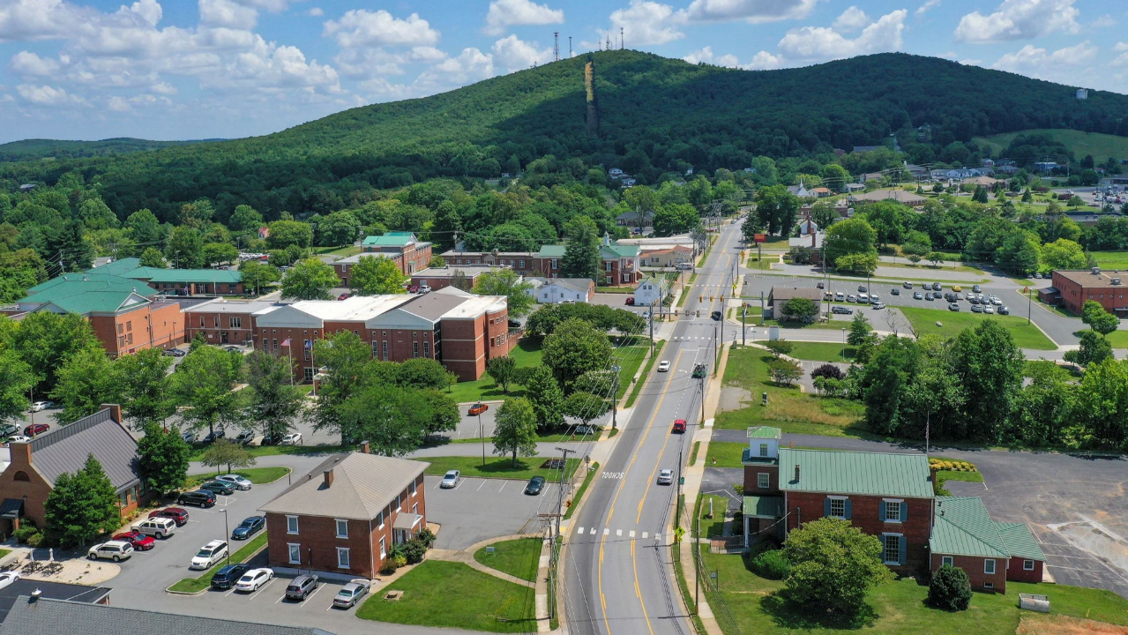

Questions & Answers
Notes:
PRESENTER: CHRIS

Slide 42

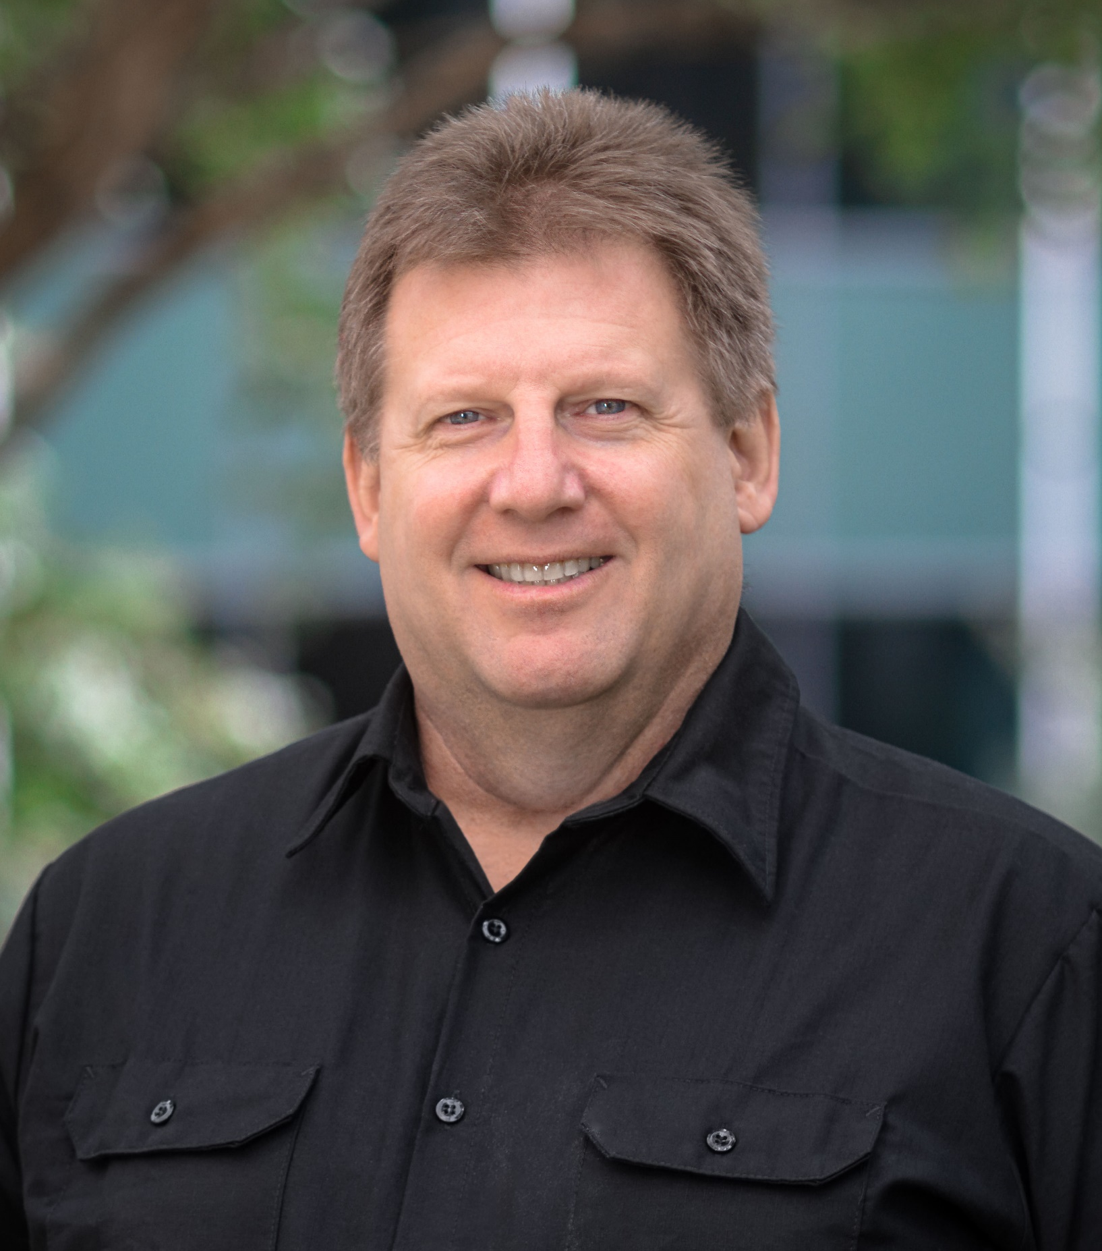
Thank You!
Brad Kelley, BSME
GBB Senior Project Engineer
(703) 663-2097
bkelley@gbbinc.com
“I help our clients develop efficient, cost-effective solutions for material handling systems and equipment to realize maximum waste diversion and recycling.”

